Slide 1


Slide 2
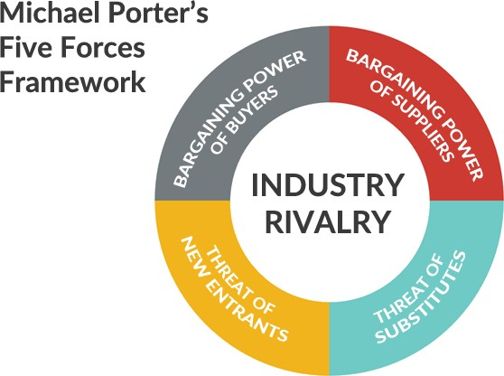

Slide 3

The Power of Suppliers

Slide 4
The Power of Suppliers
Suppliers are those who supply the organization with what it needs to produce the product or service

Slide 5
The Power of Suppliers
1
Concentrated Suppliers
Where just a few producers dominate supply, suppliers have more power over buyers.
Example: The iron ore industry is now concentrated in the hands of three main producers, leaving the steel companies, still relatively fragmented, in a weak negotiating position for this essential raw material

Slide 6
The Power of Suppliers
2
High Switching Costs
If it is expensive or disruptive to move from one supplier to another, then the buyer becomes relatively dependent and correspondingly weak
Example: Microsoft is a powerful supplier
because of the high switching costs of moving from one operating system to another. Buyers are prepared to pay a premium to avoid the trouble, and Microsoft knows it

Slide 7
The Power of Suppliers
3
Supplier Competition Threat
Suppliers have increased power where they are able to enter the industry themselves or cut out buyers who are acting as intermediaries.
Example: Airlines have been able to negotiate tough contracts with travel agencies as the rise of online booking has allowed them to create a direct route to customers

Slide 8
The Power of Suppliers
4
Differentiated products
When the products or services are highly
differentiated, suppliers will be more powerful
Example: Although discount retailers like
Walmart are extremely powerful, suppliers with
strong brands, like P&G with Gillette, still have
high negotiating power.
Also, if there is no or few substitutes for the input
the supplier group will be more powerful, like
pilots’ unions in the airline industry

Slide 9
Implications of the Competitive Five Forces
The aim of the five-force analysis is thus an assessment of the attractiveness of the industry and any possibilities to manage strategies in relation to the forces to promote long-term survival and competitive advantage

Slide 10
Implications of the Competitive Five Forces
Which industries to enter (or leave)?
How can the five forces be managed?
How are competitors affected differently?

Slide 11

Objections on Porter’s Model
The biggest objection that people have raised to Michael Porter’s ideas about strategy in recent years have to do with their difficulty in explaining the success of certain
Japanese
companies

Slide 12
Mintzberg Vs Porter
Michael Porter: Ends, ways, means
Begin with what the ends are, the position you'd like to achieve. Figure out how you're going to do it, and then the means would be what are the skills that you need to achieve that position?

Slide 13
Mintzberg Vs Porter
Mintzberg: Means, ways, ends logic
Let's figure out what we're good at. Then let's figure out where we can go with what we're good at. And then, only then, figure out what positions we might try to achieve within an industry. So, means-ways-ends versus ends-ways-means
Ways are actions. they are the methods and process executed to achieve the ends. More simply, they answer the question, How are you going to get to the end-state? Means are the resources required to execute the way.

Slide 14
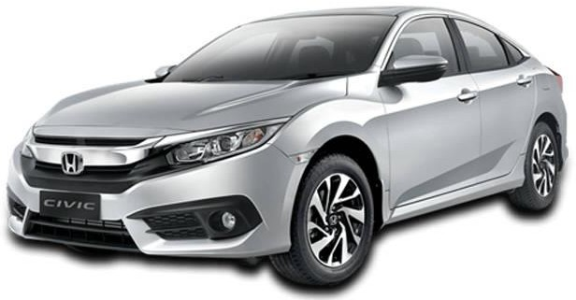
Honda in USA

Slide 15
Mintzberg Vs Porter
https://www.forbes.com/sites/karlmoore/2011/03/28/po rter-or-mintzberg-whose-view-of-strategy-is-the-most- relevant-today/#7f60cf6e58ba

Slide 16
Industry Types and Dynamics
Monopoly Industries
A monopoly is formally an industry with just one firm with a unique product or service and therefore no competitive rivalry. Because of the lack of choice between rivals and few entrants, there is potentially very great power over buyers and suppliers
Examples?

Slide 17

Industry Types and Dynamics
Monopoly Industries
Firms can still have monopoly power where they are simply
the dominant competitor

Slide 18

Industry Types and Dynamics
Monopoly Industries
Economies of scale

Slide 19
Industry Types and Dynamics
Oligopoly industries.
An oligopoly is where just a few often-large firms dominate an industry, with the potential for limited rivalry and threat of entrants and great power over buyers and suppliers. With only a few competitors the actions of any one firm are likely highly influential on the others: therefore, all firms must carefully consider the actions of all others
Example?

Slide 20
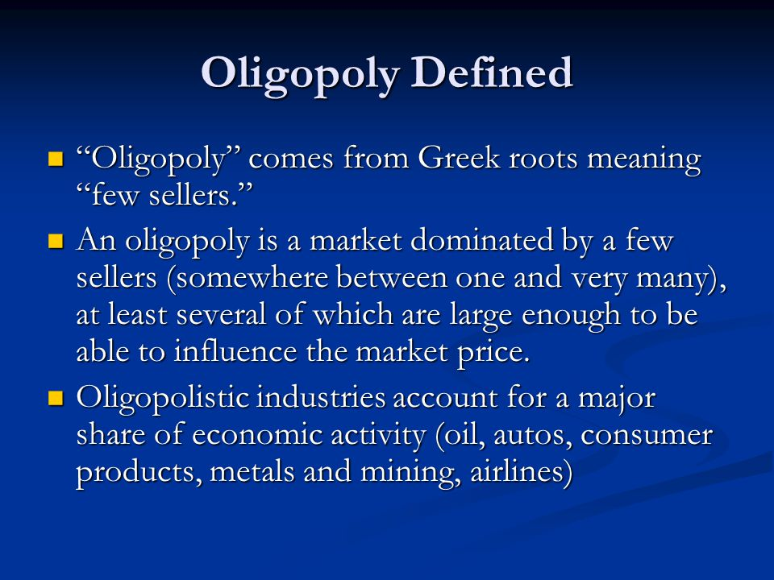

Slide 21
Industry Types and Dynamics
Perfectly Competitive Industries
Perfect competition exists where barriers to entry are low, there are countless equal rivals each with close to identical products or services, and information about prices, products and competitors is perfectly available.
Competition focuses heavily on price, because products are so similar, and competitors typically cannot fund major innovations or marketing initiatives to make them dissimilar. Under these conditions, firms are unable to earn more profit than the bare minimum required to survive

Slide 22
Industry Types and Dynamics
Hypercompetitive Industries
Hypercompetition occurs where the frequency, boldness and aggression of competitor interactions accelerate to create a condition of constant disequilibrium and change

Slide 23
Industry Types and Dynamics
Hypercompetitive Industries
Read more about this type of competition and identify
some industry….

Slide 24
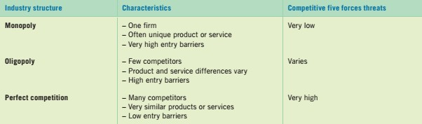
Industry Types and Dynamics

Slide 25
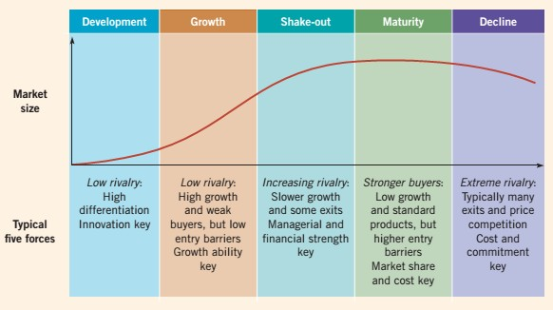
The Industry Life Cycle

Slide 26
The Industry Life Cycles
One stage does not follow predictably after another
First, industries vary widely in the length of their growth stages. For example, many internet-based industries have matured quickly and moved through the stages in less than a decade, like online travel and dating services.
Second, some industries can rapidly ‘de-mature’ through radical innovation. Thus the telephony industry, based for nearly a century on fixed-line telephones, rejuvenated rapidly with the introduction of mobile and internet telephony

